Slide 1
ANALYSIS OF SALES OF THE COMPANY
Submitted By: Arushi Mathur
Email id: aarushimathur2015@gmail.com

Slide 2
ABSTRACT
Companies Sales tells a lot about its growth and failures. So with this respect,our project is about analysis of Sales of the company and predicting various trends of it so as to help in improvising negative factors that are the obstacle in the growth of the company.
Over here we are given 2 datasets i.e. Sales Dataset and Date Dataset.
Sales Dataset has played the vital role in analyzing the growth of the company. We will be using various Machine Learning Libraries and algorithms in order to predict the best result.

Slide 3
INTRODUCTION
In this project we are aiming to achieve the growth of the company by using various Machine Learning Metrics and Data Visualization . With the help of the given dataset we are able to predict certain trends that help in analysis of Sales of the company. We have got Sales Dataset , which contain the following columns:-
transaction id : a 6-digit integer to unniquely identify each transaction. A prefix of 'c' in the transaction id indicates a cancelled transaction.
product id : Unique identifier of the item sold.
product description : Name of the product being sold.
quantity sold : quantity of the item sold.

Slide 4
transaction timestamp : the time at which transaction happened. This column can be used to join this table with the date.xlsx to obtain attributes of timestamp.
unit price : per piece price of the item sold.
customer id : Unique identifier of the customer who made the purchase.
transaction country : The country where product was sold.
The Next dataset is the Dates Dataset. It has the following Columns:
timestamp
date
day_name
day_of_month
month_of_year
time_of_day(hh:mm:ss)
So with the help of the given datasets we will be solving some problems using Machine Learning tricks in Python.

Slide 5
Libraries Used for the Project
datetime, timedelta
Pandas
matplotlib.pyplot
Numpy
Seaborn
Division
plotly.plotly
plotly.offline
plotly.graph_objs
KMeans

Slide 6
PROBLEM STATEMENTS
Q. Is the company's performance improving or degrading over time?
Solution: In order to answer the above question , let us calculate the Total Revenue of the Company – month wise. Over here , we have used the following Metric Equation to calculate the growth of the company:
Revenue=Quantity Sold * Unit Price.
Also I have Find Monthly Growth Rate and its equation is :
MonthGrowth=Revenue'.pct_change()
In the next slide I have attached the screenshot of the code:

Slide 7
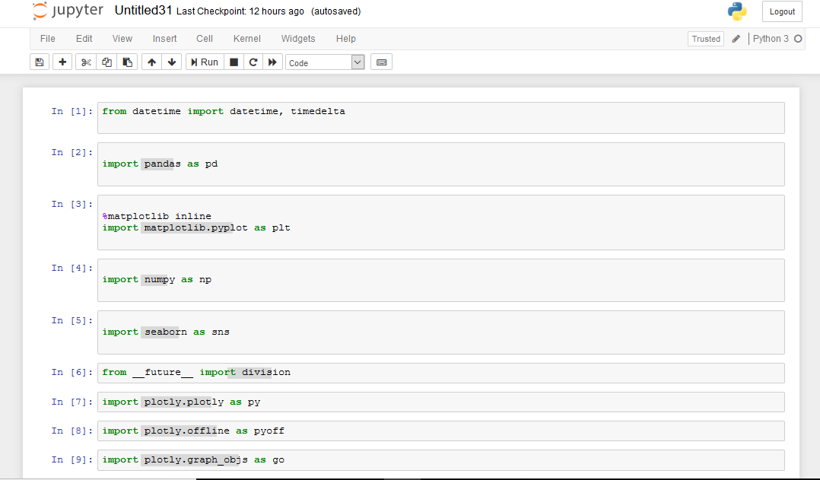

Slide 8
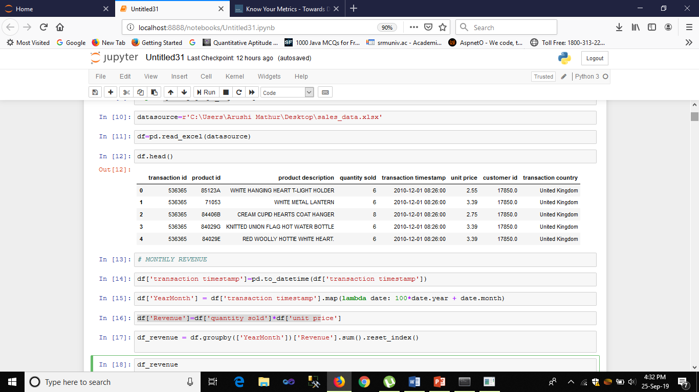

Slide 9
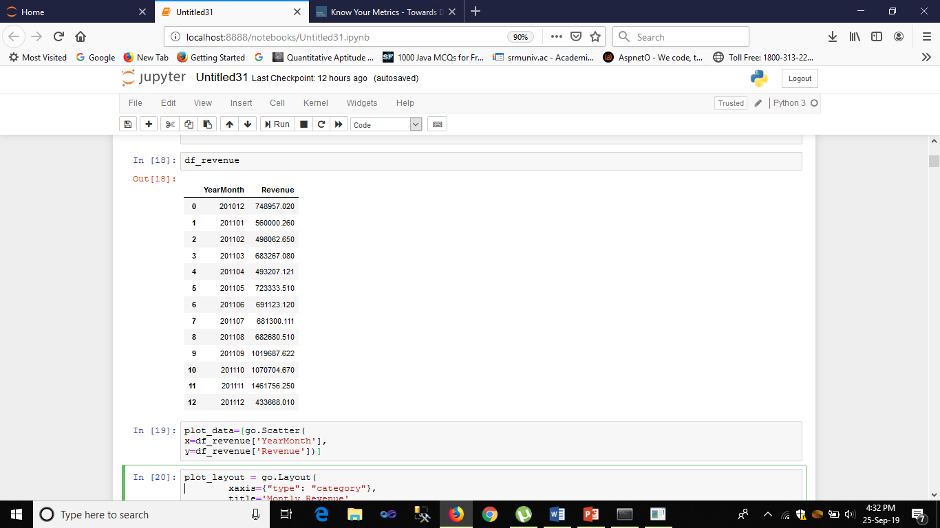
In these screenshots , we have calculated Monthly Revenue of the company.

Slide 10
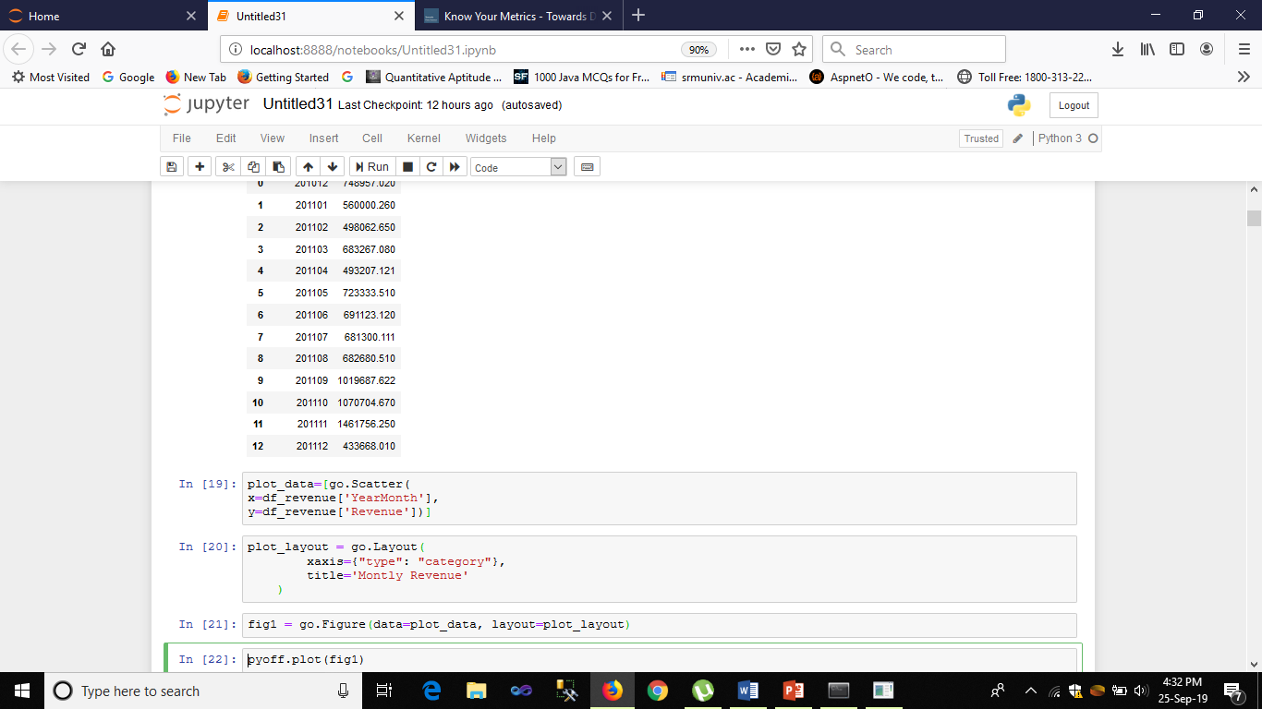
In the given sceenshot , I am trying to perform the Data Visualization and plotting the graph b/w YearMonth and Revenue

Slide 11
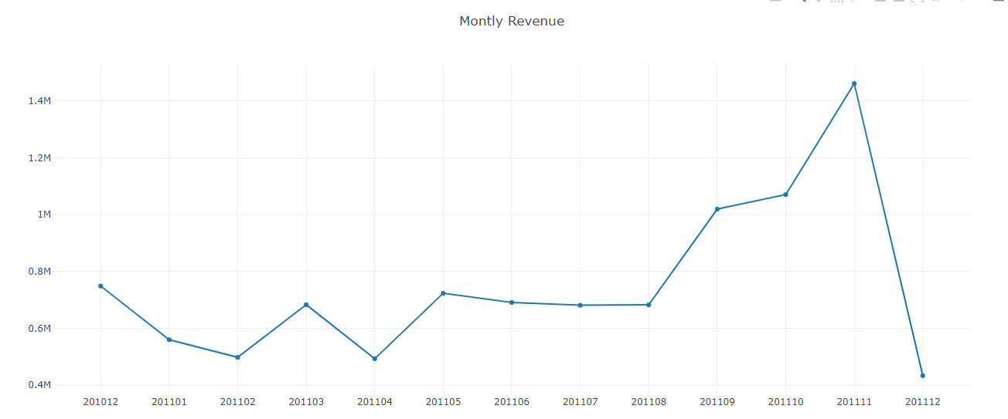
This clearly shows our revenue is growing especially Aug ‘11 onwards (and our data in December is incomplete).

Slide 12
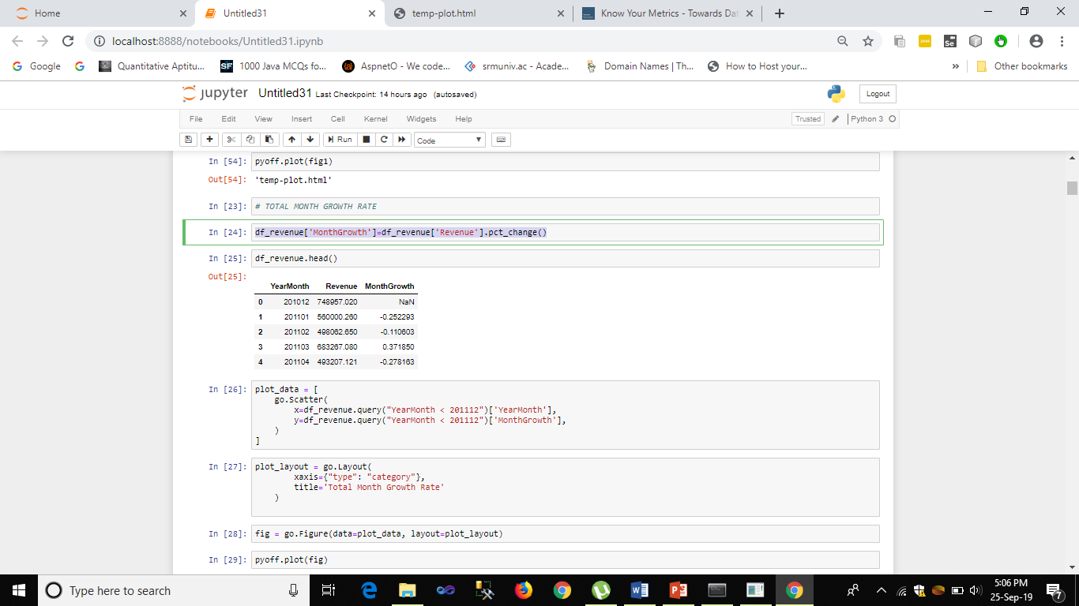
Calculating Monthly Growth Rate :

Slide 13
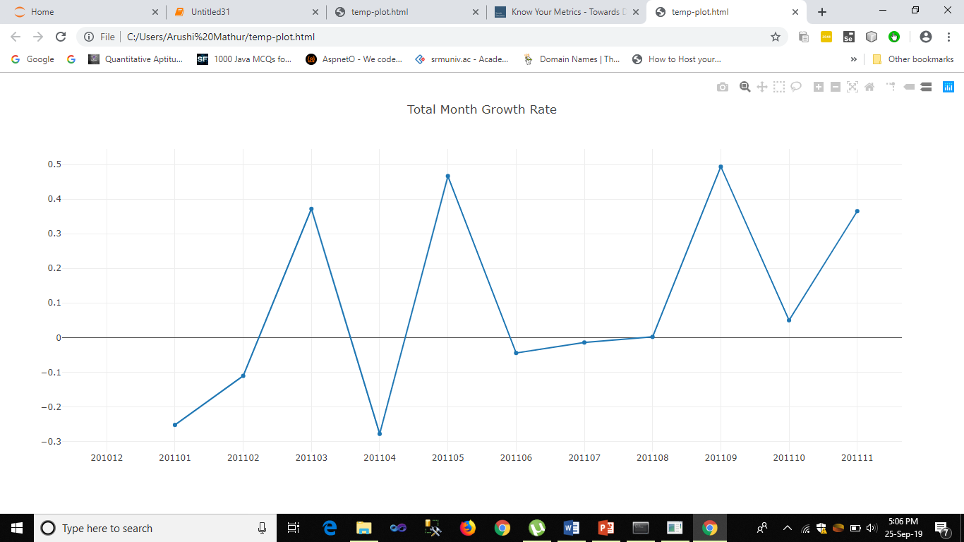
Over here we saw 36.5% growth from 201110 to 201111 i.e from Oct’11 to Nov’11. And Also from the graph we can predict that the company is mostly growing.

Slide 14
Q. Examine and highlight important trends visible in the sales data and insights.
Solution : In order to highlight important trends in Sales Data , we have listed out few Metrics that our helpful in performing the analysis of Sales of the company. These are as follows:
Monthly Active Customers
Monthly Order Count
Finding Average Revenue Per Order
New Customer Ratio

Slide 15
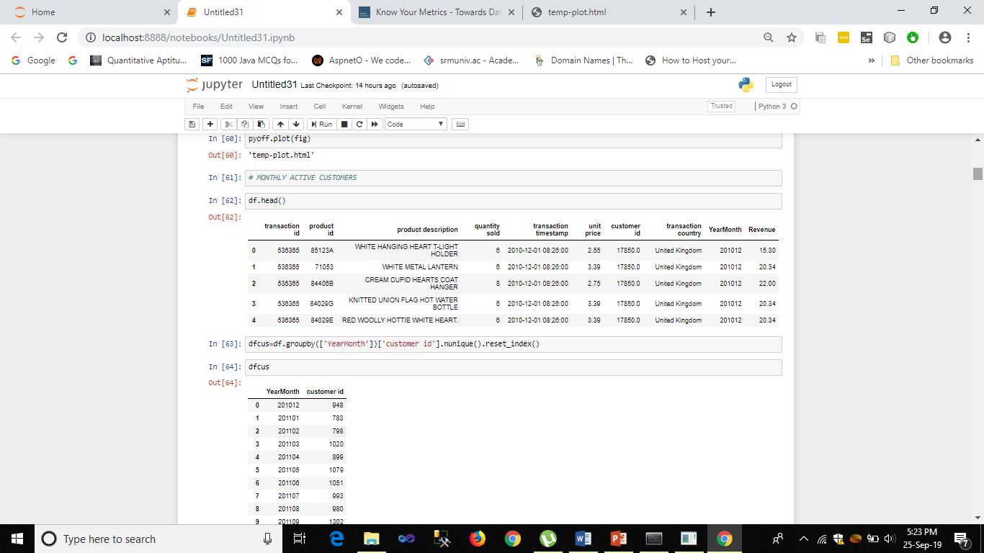
Monthly Active Customers
This basically tells about the most active customers in the month . The most important metric used here is :=
dfcus=df.groupby(['YearMonth'])['customer id'].nunique().reset_index()
We can get the monthly active customers by counting unique CustomerIDs

Slide 16
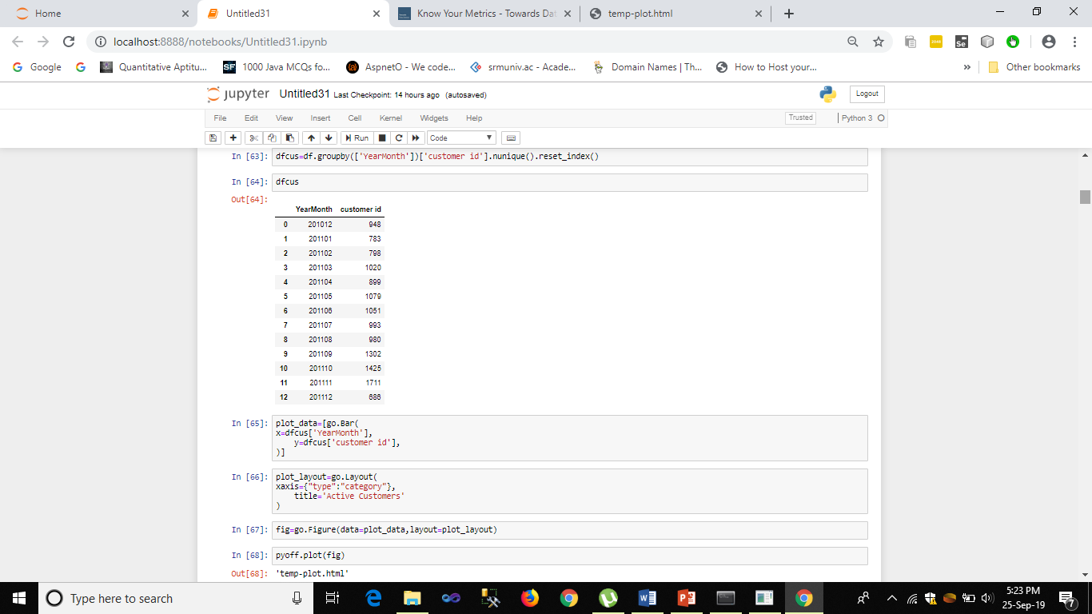

Slide 17
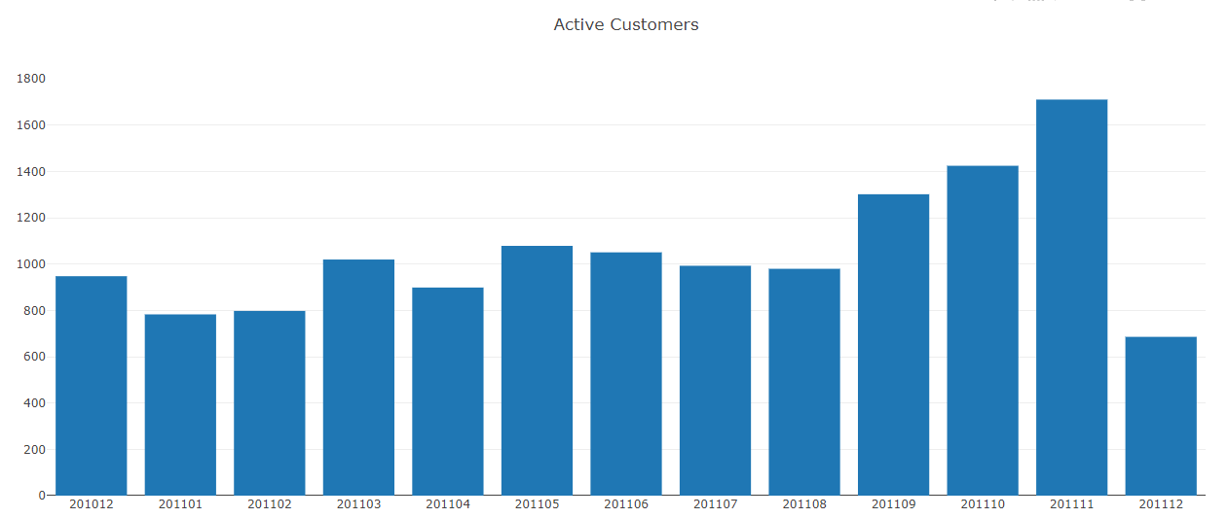
From the bar graph, it can be seen that in April, Monthly Active Customer number dropped to 817 from 923 (-11.5%)

Slide 18
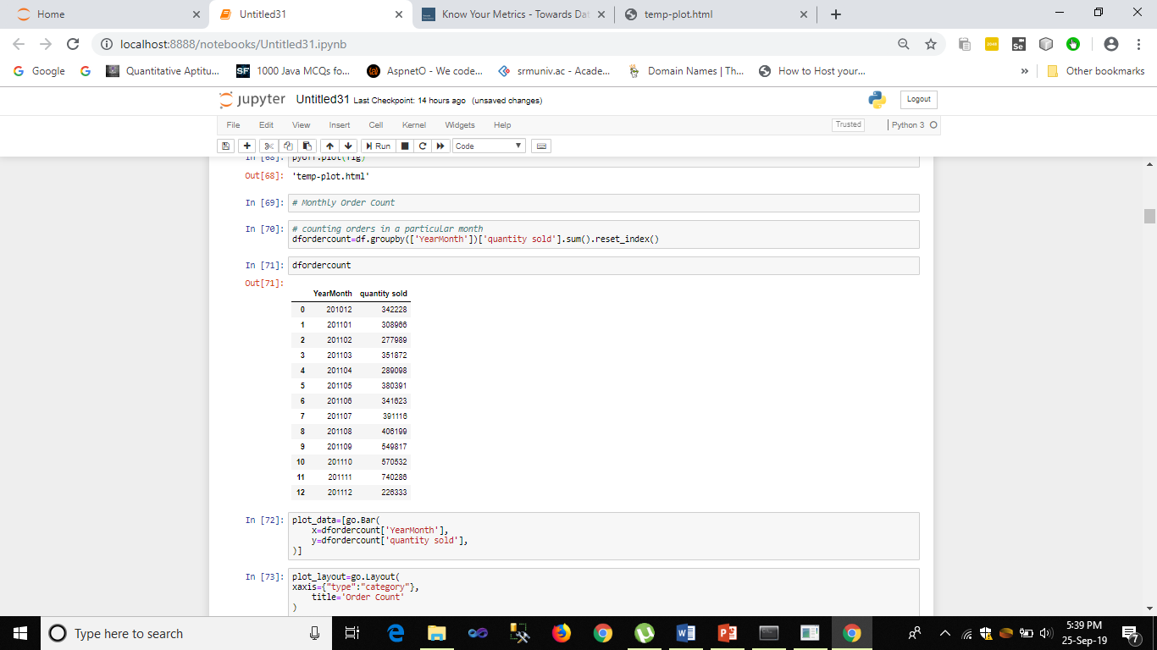
Monthly Order Count
As the name say, it basically helps in finding total order count of the month.

Slide 19
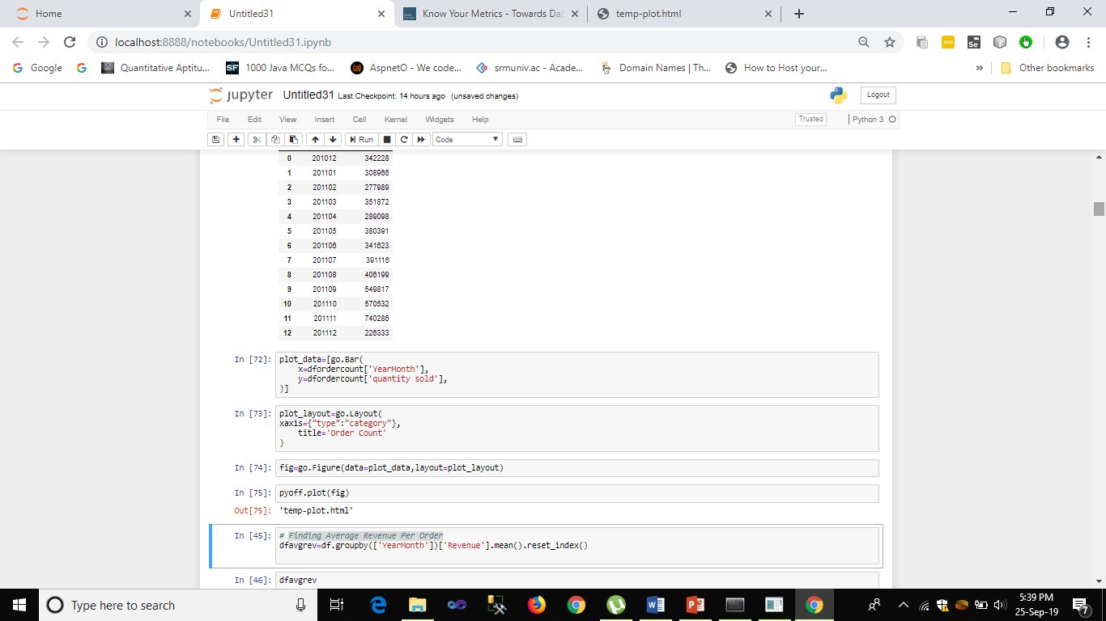

Slide 20
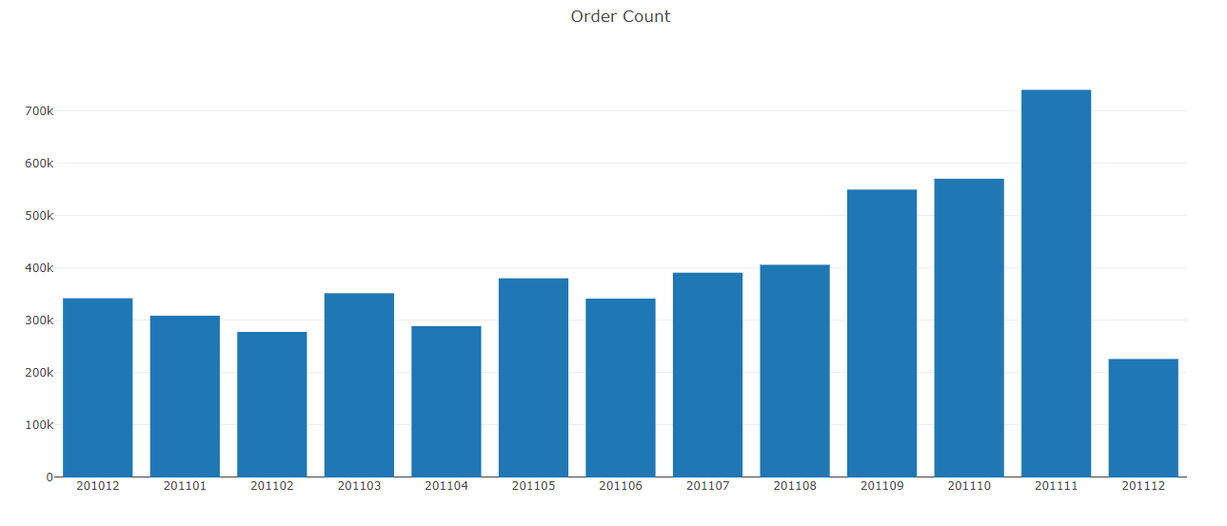
From the bar graph we can see that Order Count is also declined in April (279k to 257k, -8%)
We know that Active Customer Count directly affected Order Count decrease.

Slide 21
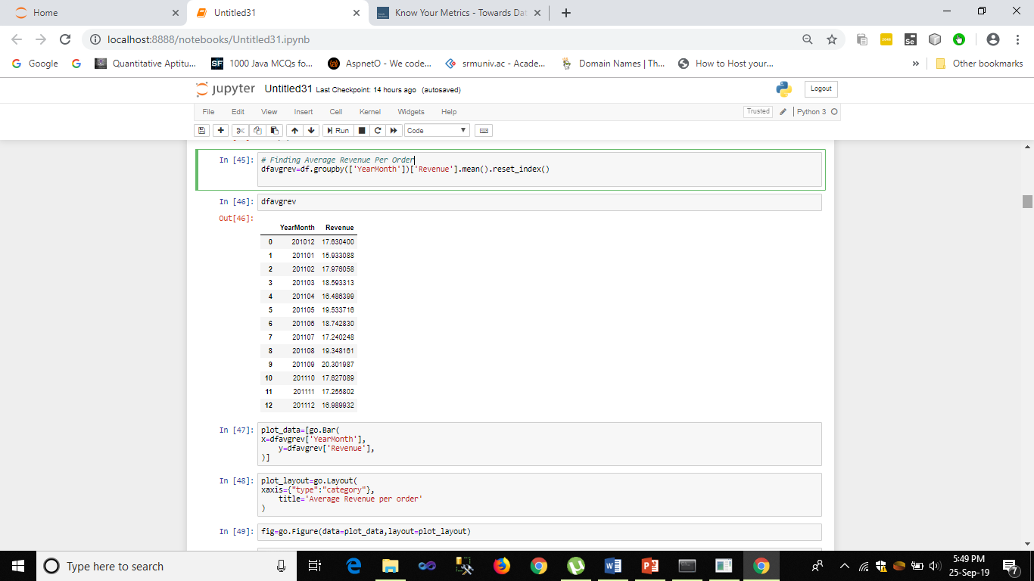
Finding Average Revenue Per Order
To get this data, we need to calculate the average of revenue for each month.

Slide 22


Slide 23
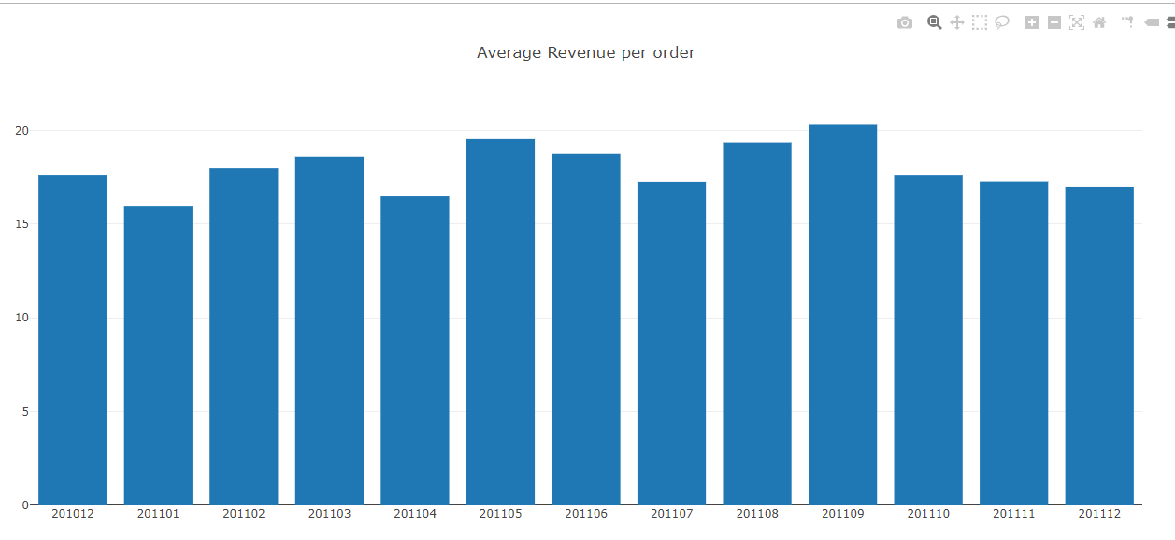
The graph is shown below:

Slide 24
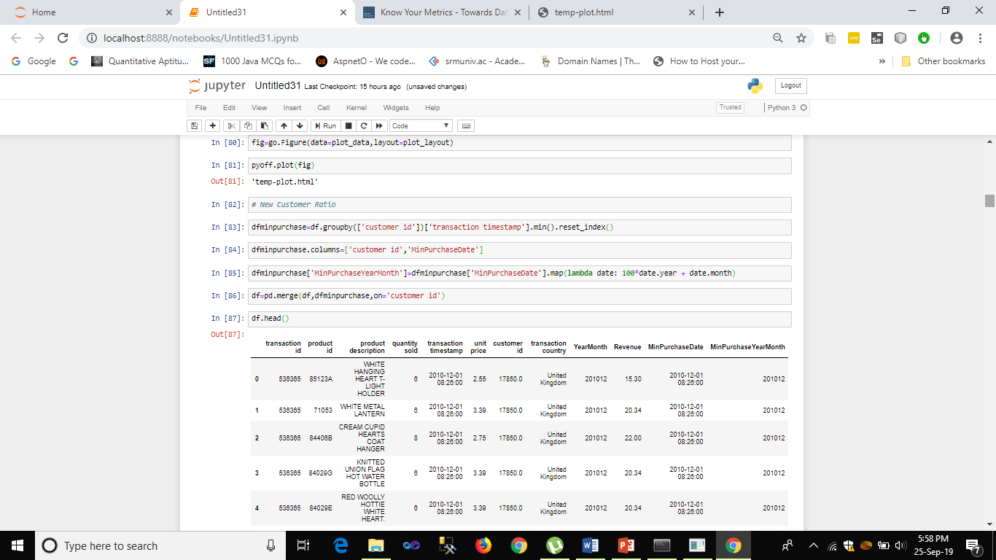
New Customer Ratio
As the name suggests it will tell about the new and the existing customers. It acts as a good indicator of if we are losing our existing customers or unable to attract new ones.

Slide 25
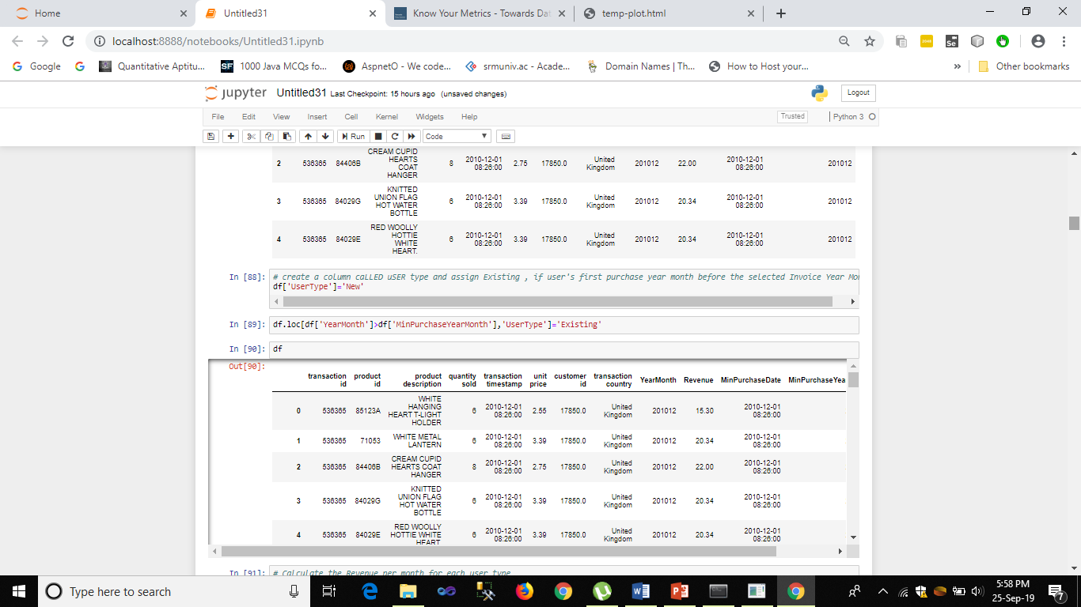

Slide 26
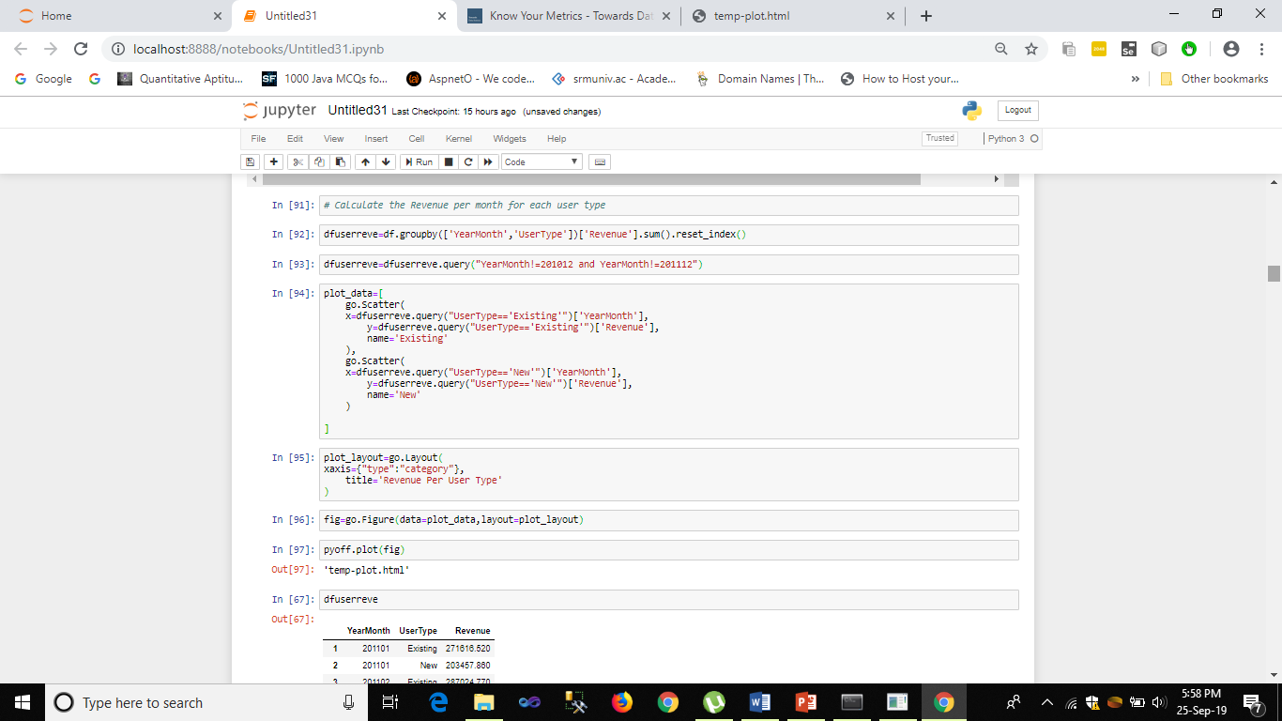

Slide 27
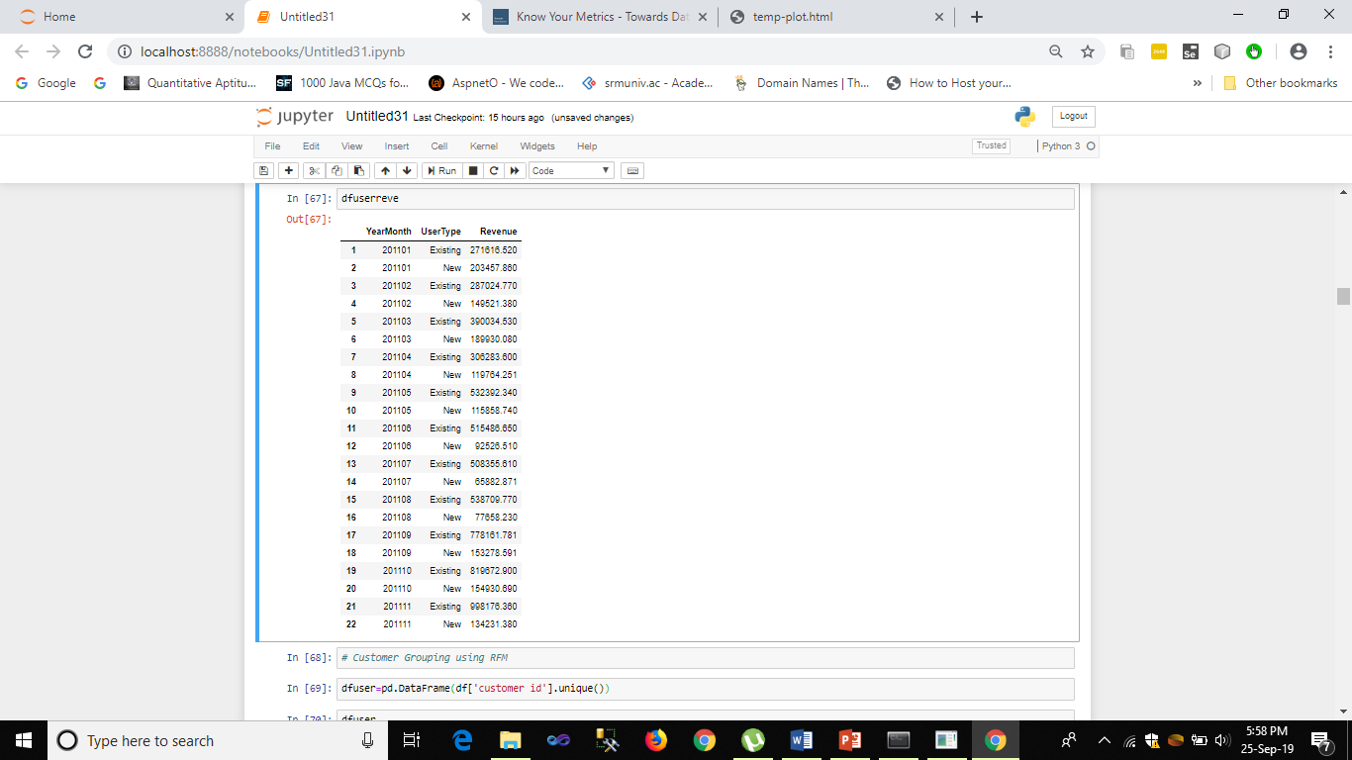

Slide 28
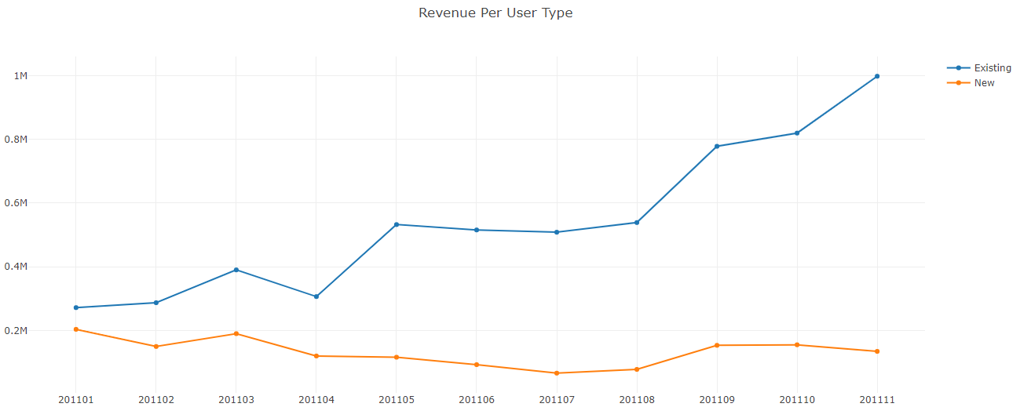
Existing customers are showing a positive trend and tell us that our customer base is growing but new customers have a slight negative trend.

Slide 29
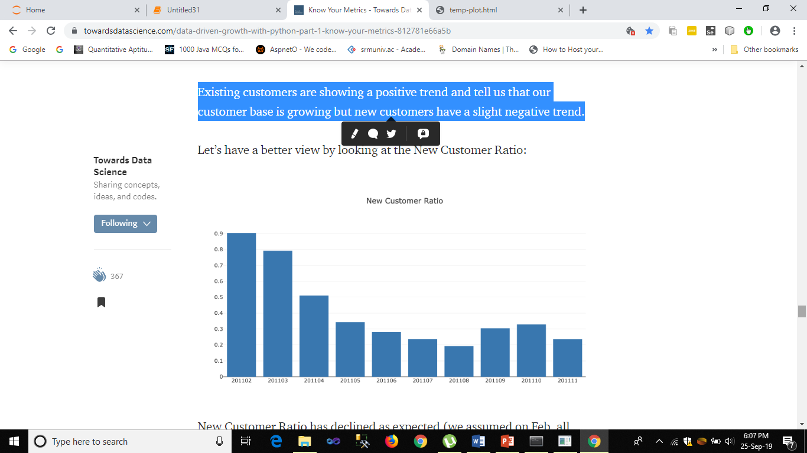
New Customer Ration Bar Graph is shown Below. It clearly shows that New Customer Ratio has declined as expected and running around 20%.

Slide 30
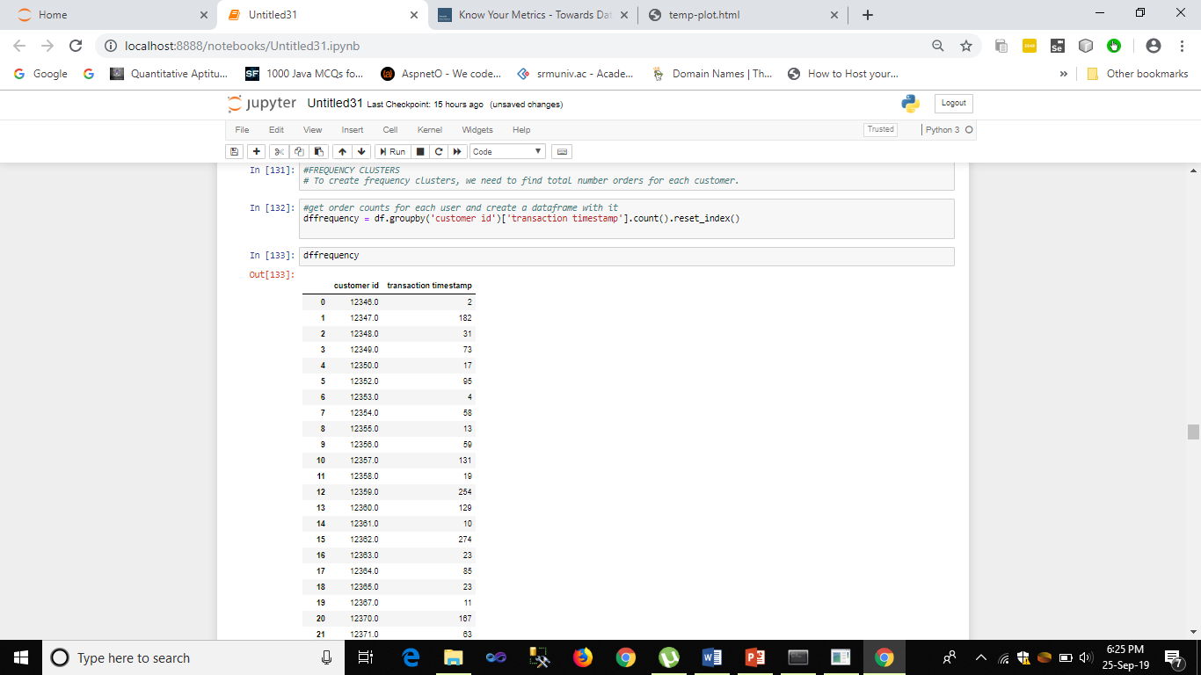
Q. How can we measure our performance in terms of customer acquisition and building customer loyalty?
Solution: We can Find out by clustering the frequency of orders per customer. If the frequency is higher then it means that there is a good acquisition in terms of the customers.

Slide 31
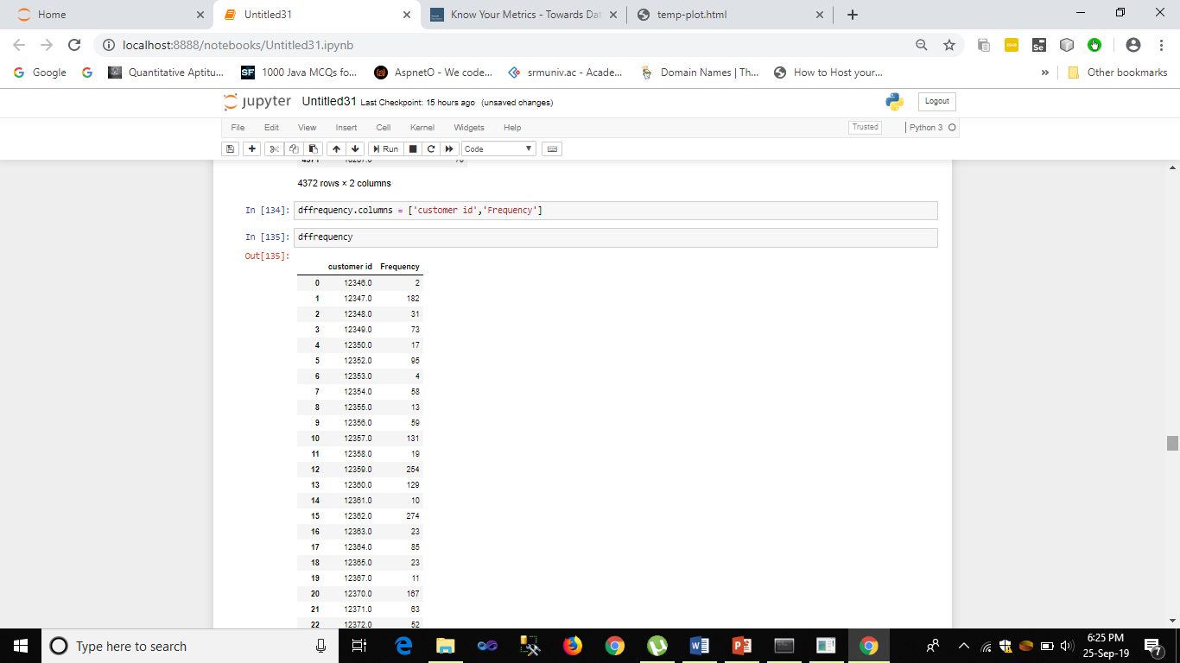

Slide 32
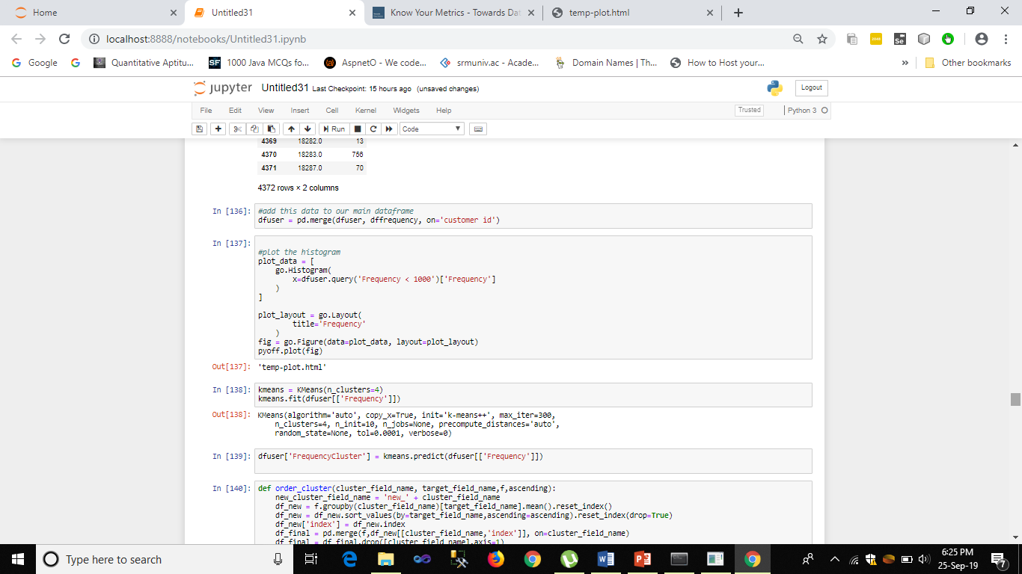

Slide 33
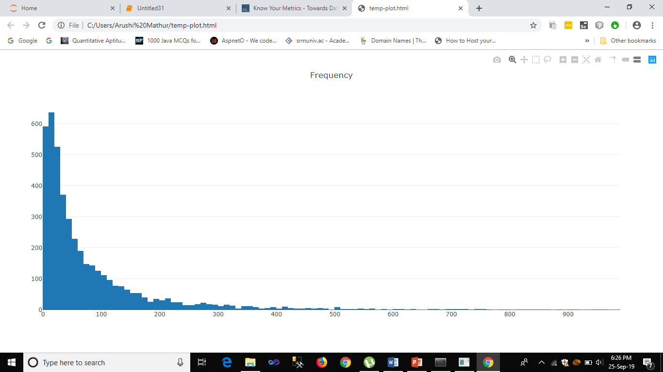
The graph shows Frequency of Orders per customers

Slide 34
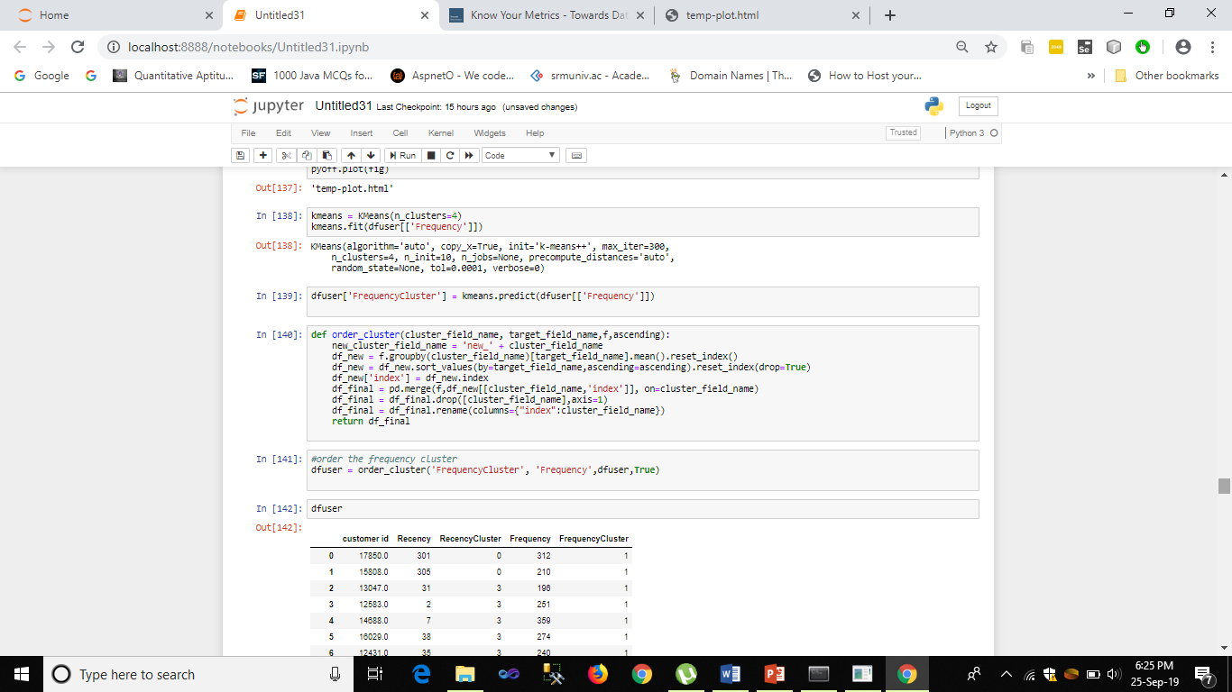
Over here , we will be grouping customers on the basis of Frequency of orders by using K means algorithm.

Slide 35
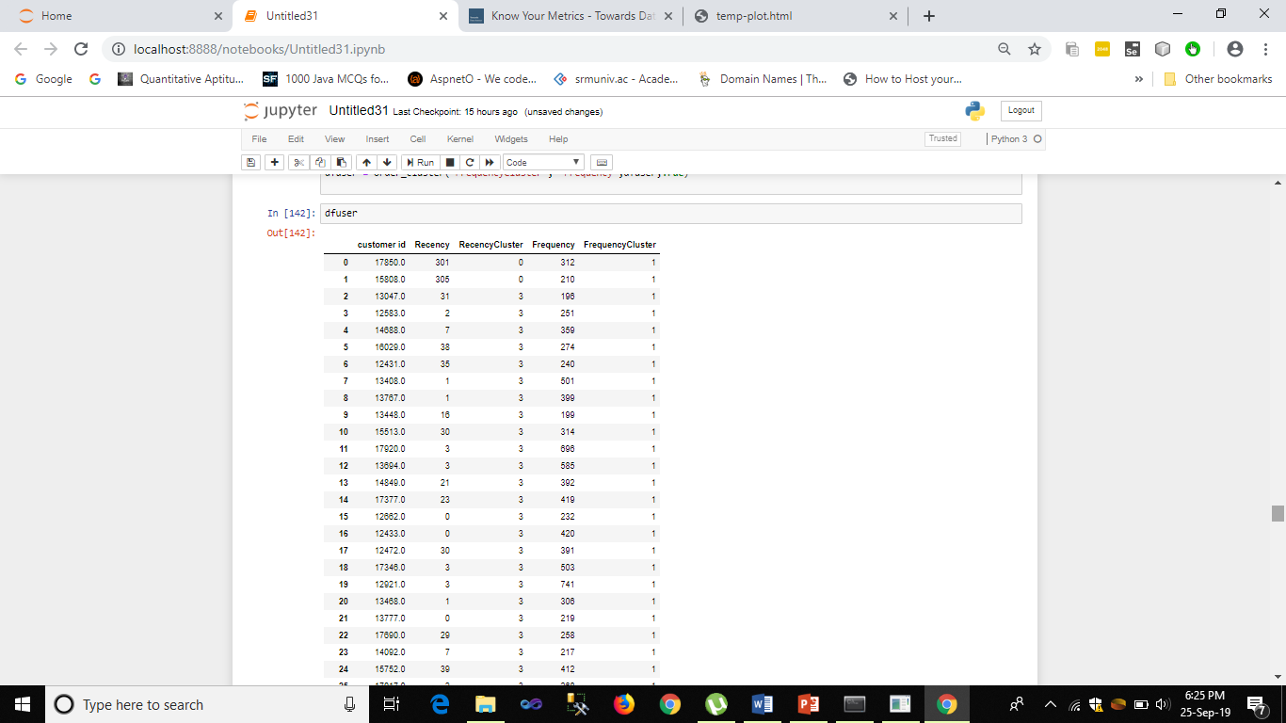

Slide 36
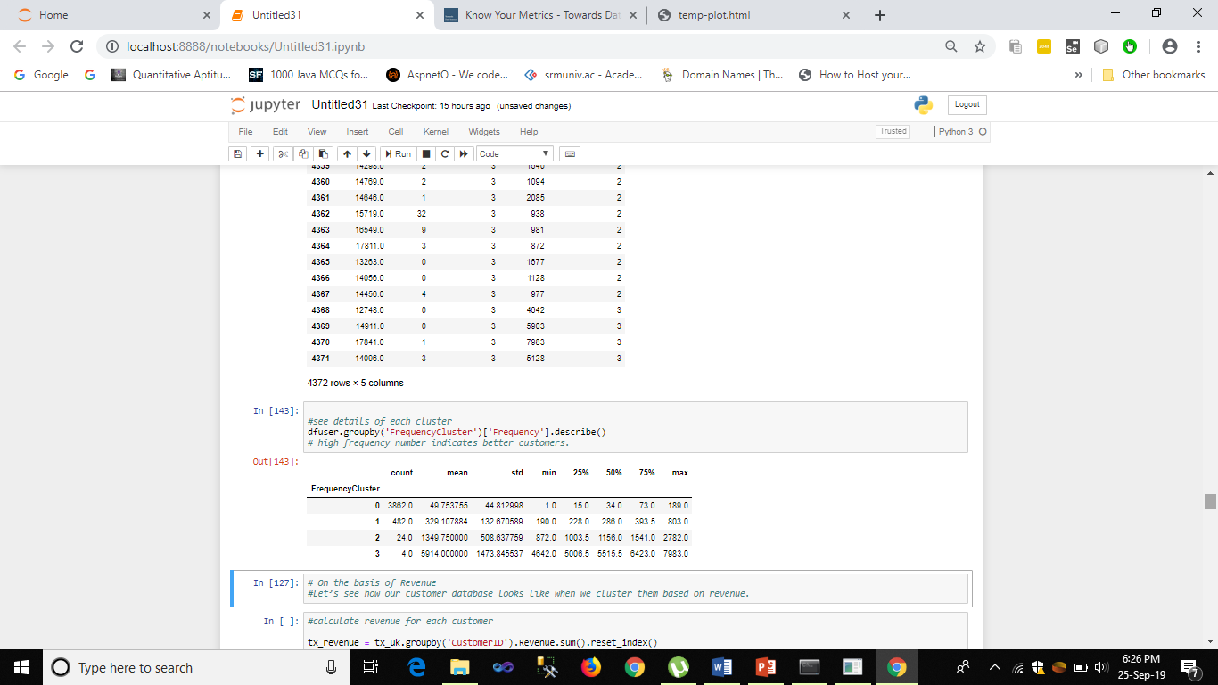
In the figure given below , it is shown that since the count of group no. 0 and 1 is higher than 2 and 3 , so we can predict that the customers from group 1 and 0 are more acquired by the company .

Slide 37
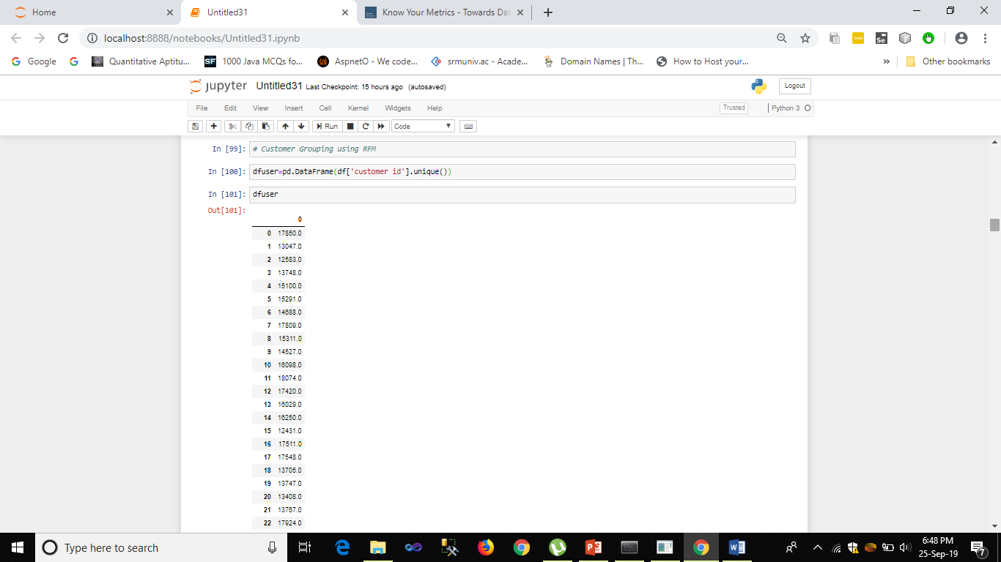
Q. What kind of customer do typically buy from us?
Solution: The answer of this question can be given by Find Recency, Frequency And Monetory Groups of the customers. Let us First Start with Recency .

Slide 38
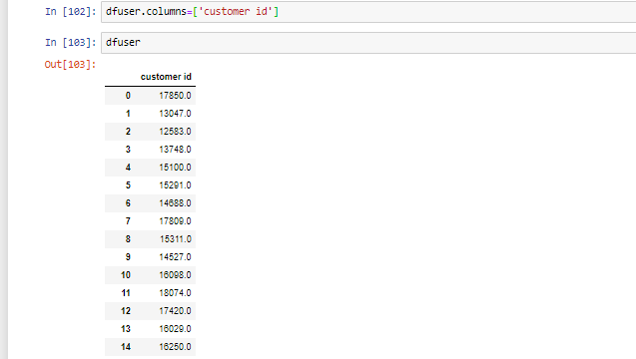

Slide 39
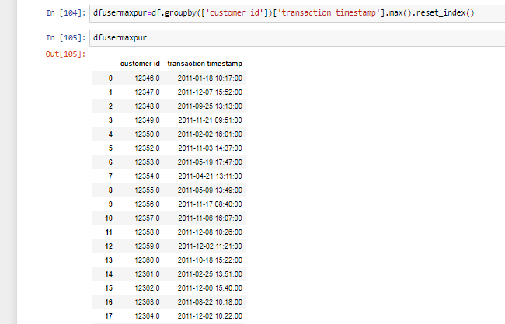

Slide 40
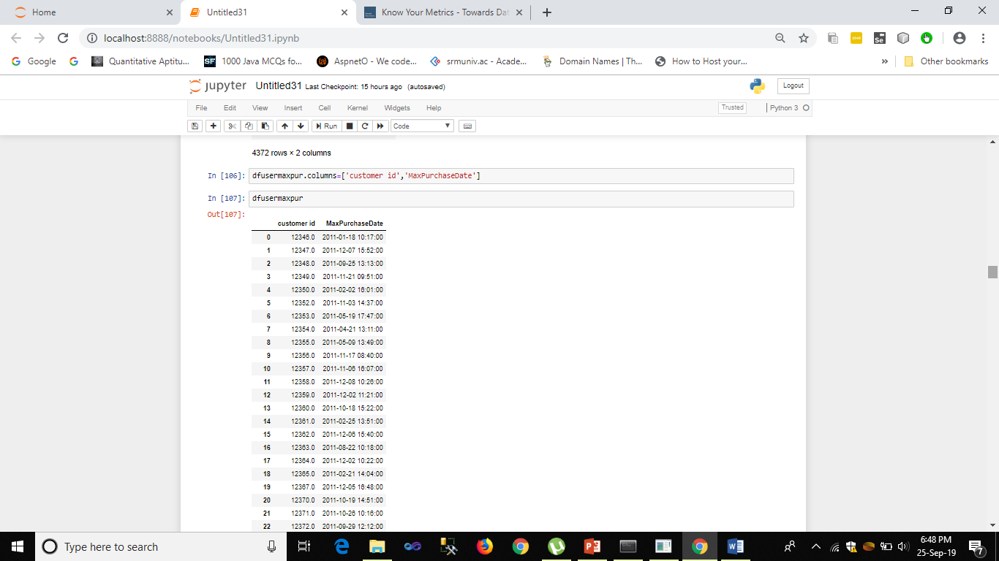
In this we have grouped the Max Purchase Date of particular customers with each of them

Slide 41
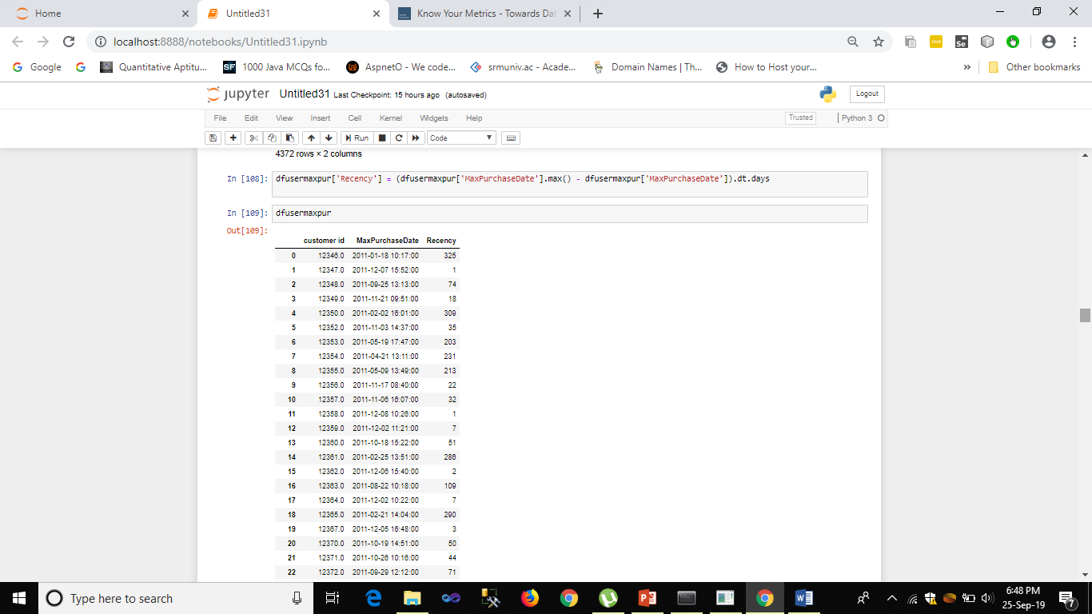
In this we have created Recency dataframe and found the recent customers.

Slide 42
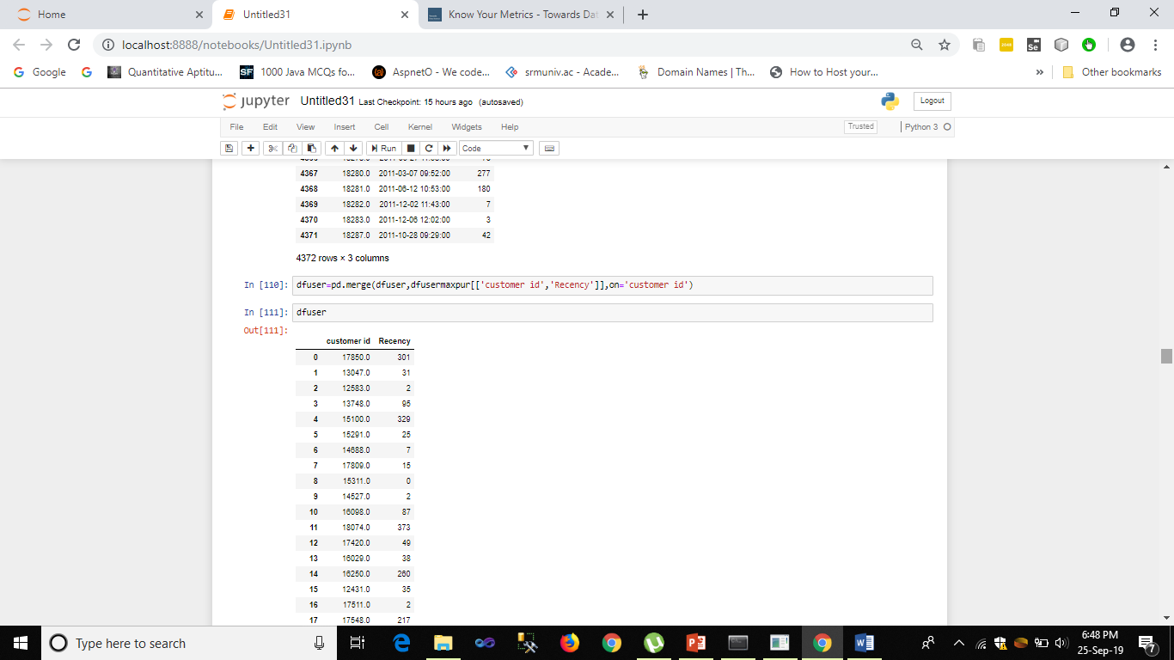

Slide 43

Now we are plotting the histogram for the Recency

Slide 44
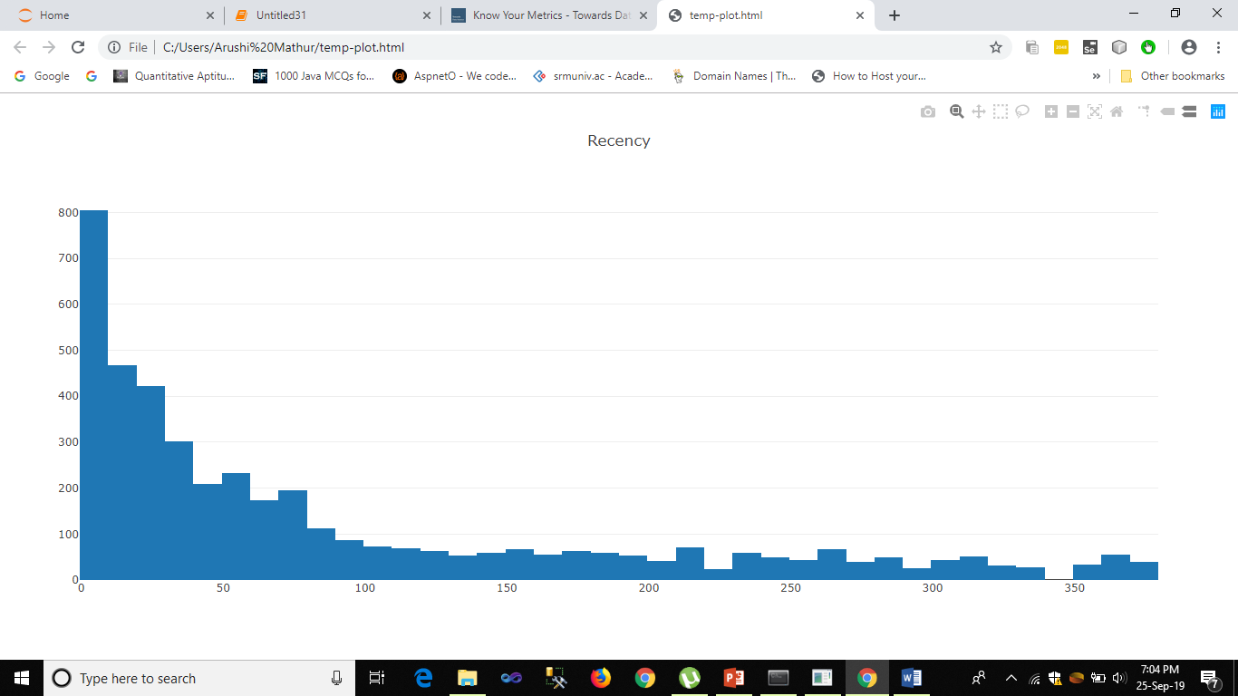

Slide 45
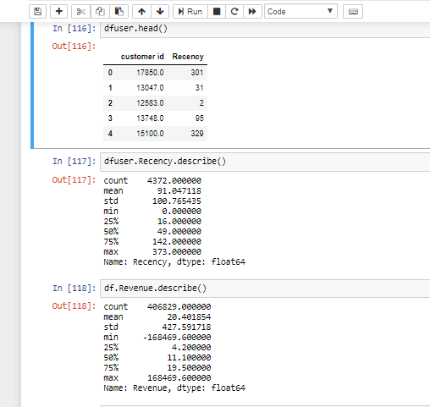

Slide 46
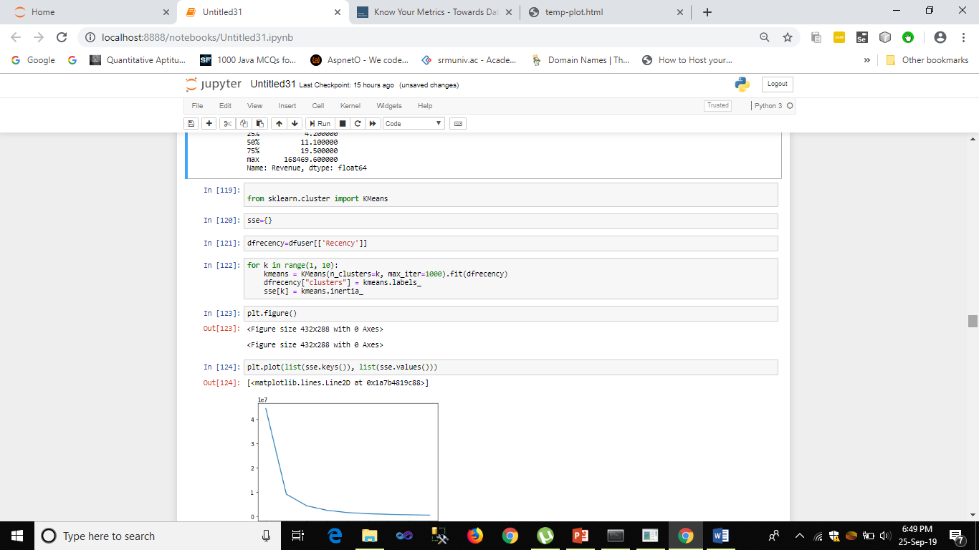
Now we will be performing the Kmeans Clustering algorithm for Recency

Slide 47
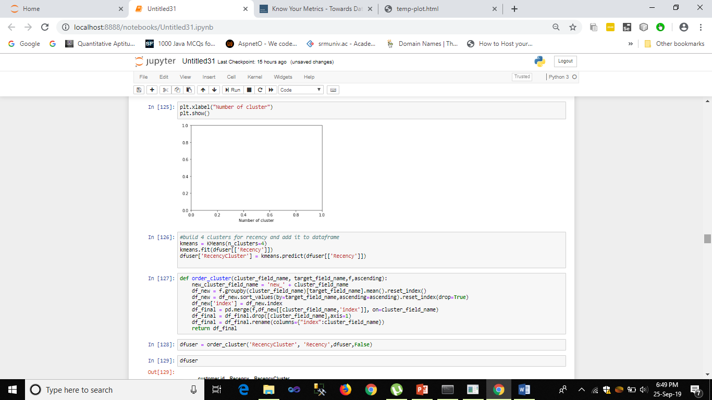

Slide 48
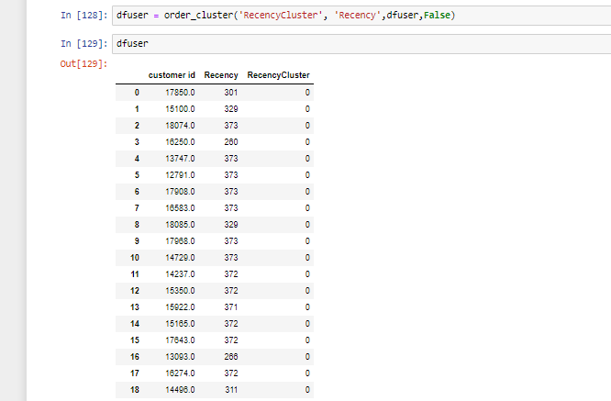
Grouping of Customers on the basis of Recency

Slide 49
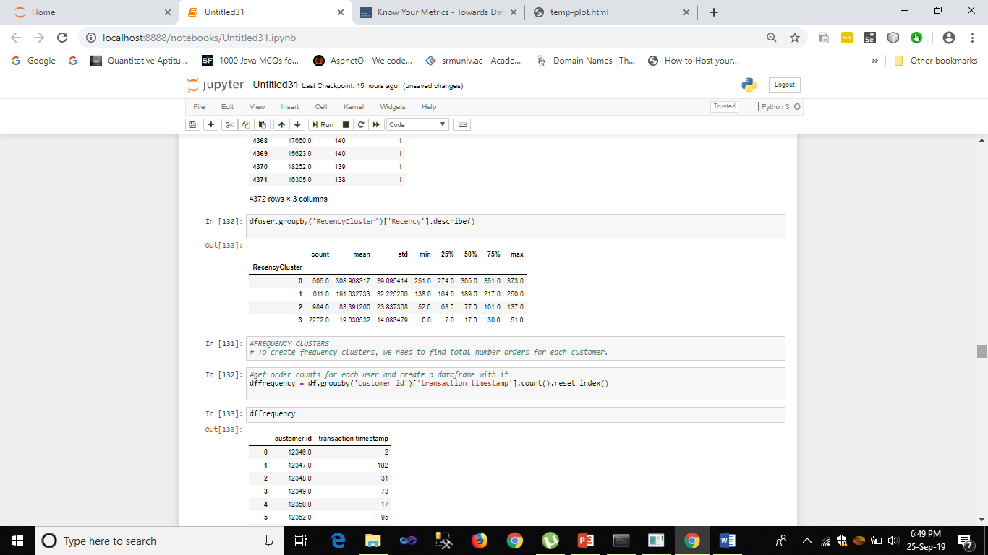
In here, it can be seen that group 0 has the highest max score so those are the most recent customers.

Slide 50
Next , We can Find out by clustering the frequency of orders per customer. If the frequency is higher then it means that these are the customers that typically buy from us.

Slide 53
The graph shows Frequency of Orders per customers

Slide 54
Over here , we will be grouping customers on the basis of Frequency of orders by using K means algorithm.

Slide 56
In the figure given below , it is shown that since the count of group no. 0 and 1 is higher than 2 and 3 , so we can predict that the customers from group 1 and 0 are more acquired by the company .

Slide 57
So from the previous predicted values, it is seen that group 0 and group 1 customers are the ones that typically buy from us.

Slide 58
Q. Identify Relationship and drivers of sales that might be hidden in the dataset.
Solution: If we talk about the relationship and drivers of sales then it can be seen that Transaction Timestamp , Unit Price and Customer Id are the most important attributes of the sales data set. We can see from the previous slides also that they are mostly the ones that are related to each other and we will be able to findout mostly all the new important attributes because of them.

Slide 59
Q. Can we take some initiation based on data to increase the sales?
Solution: Yes we can definitely take some steps to increase the sales of the company. We can do it by applying the following offers:
Applying Discount
Applying Buy One Get One Offers
But we have to keep in mind that if we try to applying some offers then also we have to increase the unit price of the item and make sure that conversion is not affected much and thus the companies’ revenue shall remain same or should increase.

Slide 60
Q. Mention based on the data , can we avoid stock situations ?
Solution: So in this case , it can be seen that the stock of items can go out of stock or it can go excess of stocks. Both can create problems , So if we are able to see the total order count of each month (let’s say in a year ) and predict the future sales then we will be able to avoid stock situations.
Thus Code for this is applied here:

Slide 61
Monthly Order Count
As the name say, it basically helps in finding total order count of the month that are sold during the particular month.

Slide 63
From the bar graph we can see that Order Count is also declined in April (279k to 257k, -8%). Thus by considering this data we can predict the future sales also and avoid stock situation.

Slide 64
Conclusion
Thus with the help of using Data Science Approach Of Metric, Data Visualization and Data Analysis together, it can be seen that we have performed the Analysis of Sales of the company which will be useful for its growth.

